Slide 1
Internet Protocol Version4 (IPv4) & Subnetting Strategy
.
BY
Mohamed Nismy

Slide 2
The Internet Protocol (IP)
The Internet Protocol is the corner-stone of the TCP/IP
architecture. All computers in the Internet understand IP.
The main tasks of IP are:
The addressing of the computers, and the fragmentation of packets.
There are two types of Internet Protocol:
Internet Protocol version 4 (IPv4): currently used version of Internet Protocol.
Internet Protocol version 6 (IPv6): the upcoming replacement for IPv4. It contains some major improvements and new features.

Slide 3
IPv4 Address:
An IPv4 address is a 32-bit address that uniquely and universally defines the connection of a device (for example, a computer or a router) to the Internet.
• Connectionless protocol
• Fragments (divides) packets where necessary
• Addressing via 32 bit Internet addresses
However, it contains no functions for end-to-end message reliability or flow control. IP makes the ‘best effort’ to forward packets to the next destination, but does not guarantee delivery because it is connectionless.

Slide 4
Cont…
The IP address can be classify into two classes:
Public address:
This address considered as any valid address assigned to any user, and the organization who is responsible for registering IP ranges called Internet Service Providers (ISPs), and this address will be unique.
Private Address:
Any number or address assigned to a device on a private TCP/IP Local Area Network that is accessible only within the Local Area Network.

Slide 5
Internet Protocol Version 6 (IPv6) SIPP (Simple Internet Protocol Plus)
• Maintains good features of IPv4, discards bad ones.
• Not compatible with IPv4
• Compatible with all other Internet protocols including
TCP, UDP, ICMP, DNS, etc.
• Main features:
– Long addresses (128 bits) ⇒ supports billions of hosts.
– Simplified, fixed size header ⇒ routers can process packets faster.
– Support for authentication and privacy
– Better support for type of service.

Slide 6
Internet addresses
Each network interface connected to the Internet has a unique address consisting of two parts:
Network address, address of the network within the Internet (used by gateways for routing IP packets between networks).
Host address, address of the computer within the network (used for delivering packets to a particular network interface within the network).

Slide 7
Internet address format
The 32-bit IP address is separated into four 8-bit octets, allowing each octet to have a value ranging from 0 to 255.
Furthermore, the IP address is logically separated into two distinct components: the network ID and the host ID. The network ID is used to identify the subnet upon which the host resides. The host ID is used to identify the host itself within the given subnet.
IP addresses can be displayed in three typical formats:
Binary notation Binary notation is the format that systems on the network use to process the address. An example of binary notation is 11000000.10101000.00000001.01100100.
Hexadecimal notation Hexadecimal notation is the format typically used when identifying IPv6 addresses. An example of hexadecimal notation of an IPv4 address is C0.A8.01.64

Slide 8
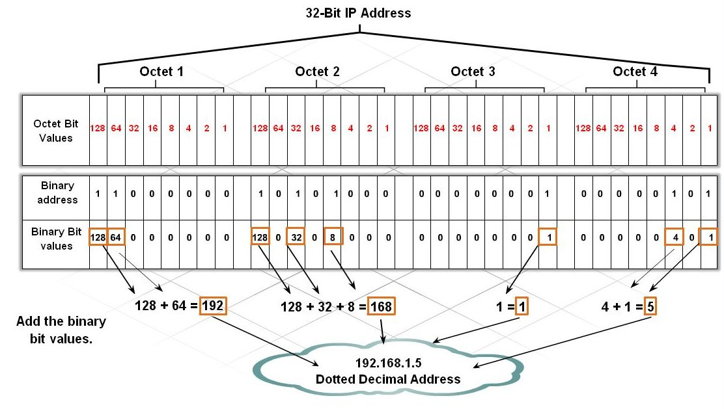
Cont…
Dotted-decimal notation Dotted-decimal notation is the format that is typically used for displaying the IP address in a human-readable format. An example of dotted-decimal notation is 192.168.1.100
Figure 3: Structure of IP Address

Slide 9
Classes of IP addresses
Different networks have different sizes. Basically, there are many small networks and few large networks.
To provide efficient use of 32-bit address space, IPv4 defined several address classes and associated address formats:
Class A: allows 128 networks, 16 million hosts each.
The IP address start from 1.0.0.0 to 127.255.255.255, and the mask address is 255.0.0.0
Class B: allows 16,382 networks, 65,534 hosts each.
The IP address start from 128.0.0.0 to 191.255.255.255, and the mask address is 255.255.0.0

Slide 10
Classes of IP addresses
Class C: allows 2 million networks, 254 hosts each.
The IP address start from 192.0.0.0 to 223.255.255.255, and the mask address is 255.255.255.0
Class D: multicast networks The IP address start from 224.0.0.0 to 239.255.255.255.
Class E: reserved for future use. From 240 to 255 and the 255.255.255.255 used for broadcast to all the subnet.

Slide 11
Cont..
One of the benefits of classful addresses is that they provide a hierarchy to the network through the use of the network ID. This translates into an efficient routing environment because it is easy for a router to determine what networks can be grouped together and treated as a single routing entry.

Slide 12
Strategies to Conserve Addresses
Several strategies have been developed and implemented to help the Internet community on how provides a good managing of IP addresses. These strategies help reduce the load on Internet routers and help administrators use globally unique IP addresses more efficiently. There are two common strategies, which are:
Private Addressing
Classless Inter-Domain Routing (CIDR)

Slide 13
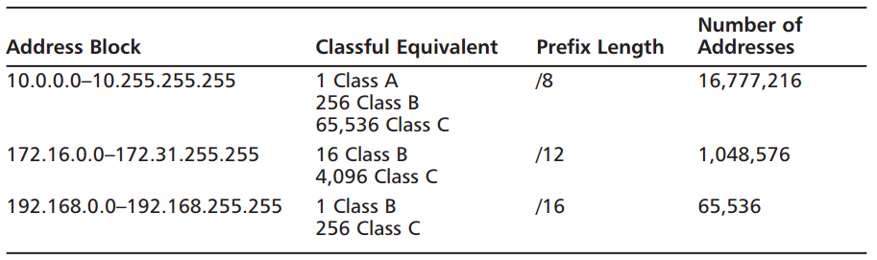
Private Address
It means If the internetwork is limited to one organization, the IP addresses need only be unique within that organization. Only networks that interface with public networks such as the Internet need public addresses. Using public addresses on the outside and private addresses for inside networks is very effective.
Private Addresses:-
RFC1918 designates three ranges of IP addresses as private:
10.0.0.0 through 10.255.255.255
172.16.0.0 through 172.31.255.255
192.168.0.0 through 192.168.255.255

Slide 14
Cont…

Slide 15
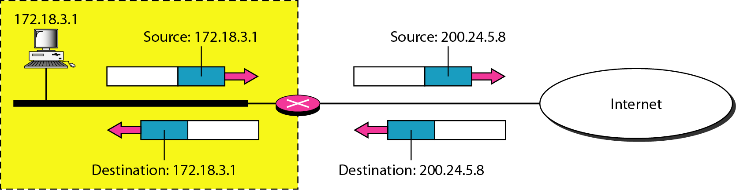
Cont...
There are two ways to convert the private address to public address:
Network Address Translation (NAT).
This technique has been used to convert the private address to public address, the NAT allowing us to access the internet and get services. The basic idea, is that technique used pool of public addresses and assign for each private address one public address. Thus, this way is inefficient due to the fact that there are cost and delay associated with this operation. The table and the figure below show how the NAT make the mapping.
Private Address | Public Address
192.68.5.1 | 200.1.1.2
192.68.5.2 | 200.1.1.3
192.68.5.3 | 200.1.1.3

Slide 16
Cont..
Port Address Translation (PAT).
It’s another technique used to convert the private address to public. During PAT, each computer on LAN is translated to the same IP address (public), but with a different port number assignment. This way is much better than the NAT because we can use one public address to translate any private address, therefore we saved the cost. The table below shows the process of the PAT
The port address will be any random number in the allowed range, that the device created it when wants to access the internet.
The packet will contain the port number that assign to the device that wants to access the internet and through this port number, the router when get the response message will translate it and make map this message to it is private address based on the port number.
Private Address | Port address | Public Address | Port Number
192.68.1.3 | 50133 | 200.0.1.2 | 1
192.68.1.5 | 63887 | 200.0.1.2 | 2

Slide 17
Addressing without Subnets
If we have a class B with a Flat Network, the number of host will be more than 2¹⁶=65536 hosts,
So the problem is here, that managing this network with this number of host is too tricky and the performance of this network will get down because of the heavy load. In other word, any single broadcast can slowdown the network.
Therefore, the solution is the subnetting. Subnetting means divide or separate the single network into multiple networks that can reduce the loading from one network.
The advantage of using subnetting is:-
1. Reduce the traffic and the increase the performance.
2. The smaller network can easier to manage.

Slide 18
Subnetting
As the number of distinct local networks grows, managing them become a serious headache. Every time a new network is installed the system administrator must contact NIC to get a new network number.
The solution to the problem is to allow a network to be split into several independent parts for internal use but still act like a single network to the outside world. In the internet literature these parts are called subnets.

Slide 19
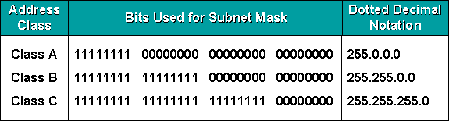
Subnet masks:-
A mask is a 32-bit binary number that is expressed in dotted decimal notation. By default, a mask contains two fields, the network field and the host field. These correspond to the network number and the locally administered part of the network address. When an administrator subnets, they are adjusting the way they view the IP address. Table 1: Default masks for classful addressing

Slide 20
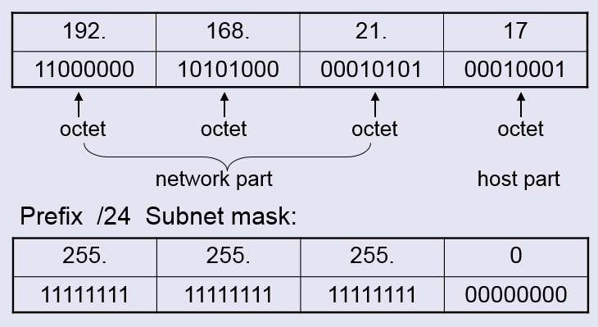
Cont…
Routers and hosts still assume class subnet masks by default:
Class A /8 255.0.0.0
Class B /16 255.255.0.0
Class C /24 255.255.255.0
The figure below gives an example to class C mask address:
The first three octets represent the network part and the last octet represent the host part.

Slide 21
Cont...
There three important things that should be taken into our account when we thinking about subnetting:-
Network address – the first one
Broadcast address – the last one
Host addresses – everything in between
As well as, to find the number of hosts per subnet. We can use formal 2^{x} -2, where (x) is the number of unmasked bits (0’s) .

Slide 22
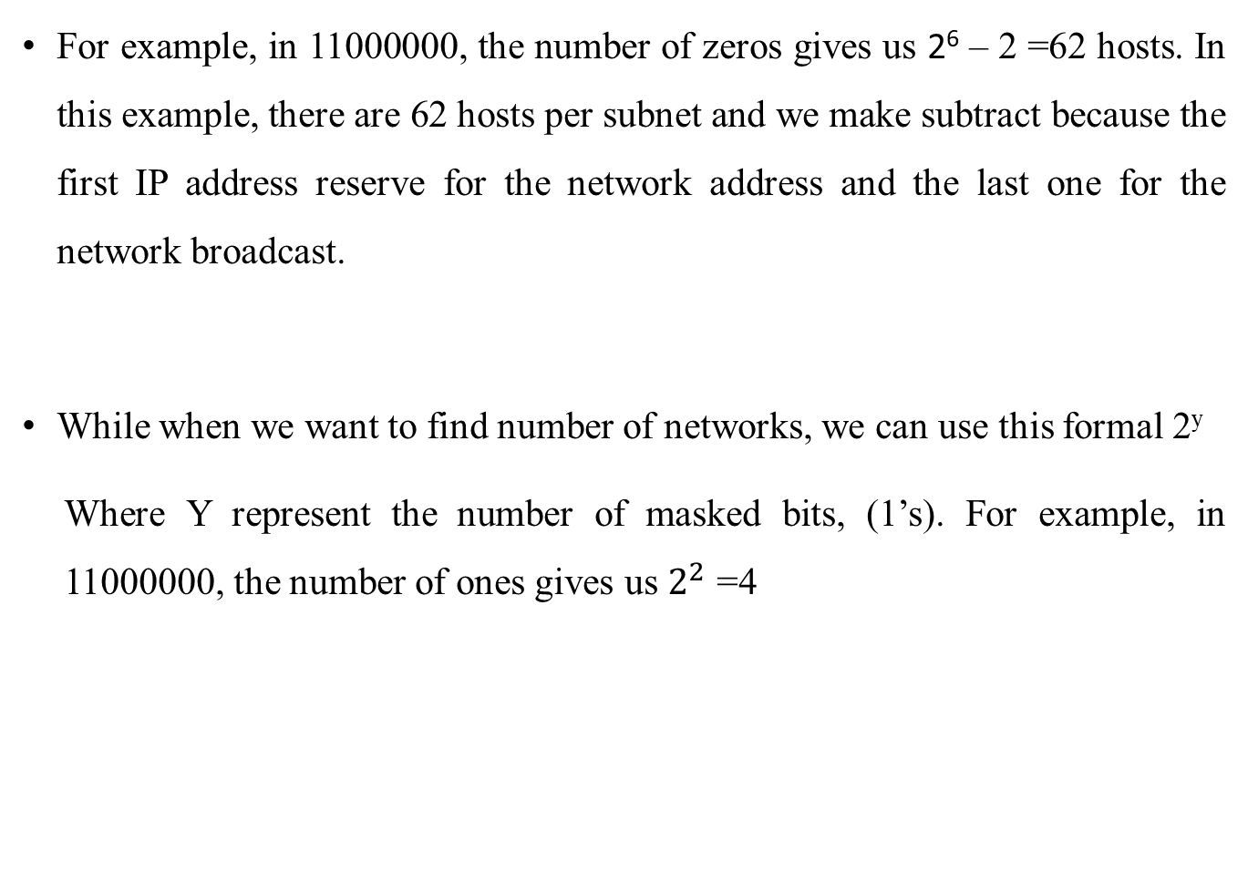
Cont...
For example, in 11000000, the number of zeros gives us 2⁶ – 2 =62 hosts. In this example, there are 62 hosts per subnet and we make subtract because the first IP address reserve for the network address and the last one for the network broadcast.
While when we want to find number of networks, we can use this formal 2^{y}
Where Y represent the number of masked bits, (1’s). For example, in 11000000, the number of ones gives us $2^{2}$ =4

Slide 23
Reserved and Restricted Addresses
In any subnet, there are certain addresses that cannot be assigned to an individual device because they have a special purpose. The subnet address is the first address in a range that identifies the subnet. The broadcast address is the last address in the range, and all hosts on the subnet receive traffic if anything is sent to it.
Assume that a subnet address is 172.31.9.0 with a mask of 255.255.255.0. The subnet address is 172.31.9.0, and the broadcast address is 172.31.9.255.

Slide 24
Classless Inter-Domain Routing (CIDR)
Classless Inter Domain Routing (CIDR) is a method for assigning IP addresses without using the standard IP address classes like Class A, Class B or Class C. In CIDR , an IP address is represented as A.B.C.D /n, where "/n" is called the IP prefix or network prefix. The IP prefix identifies the number of significant bits used to identify a network.
Example, 192.9.205.22 /18 means, the first 18 bits are used to represent the network and the remaining 14 bits are used to identify hosts.

Slide 25
It’s basically the method that ISPs (Internet Service Providers) use to allocate an amount of addresses to a company, a home—a customer. They provide addresses in a certain block size
When you receive a block of addresses from an ISP, what you get will look something like this: 192.168.10.32/28. This is telling you what your subnet mask is. The slash notation (/) means how many bits are turned on (1s).
The Class A default subnet mask, which is 255.0.0.0. This means that the first byte of the subnet mask is all ones (1s), or 11111111. When referring to a slash notation, you need to count all the 1s bits to figure out your mask. The 255.0.0.0 is considered a /8 because it has 8 bits that are 1s—that is, 8 bits that are turned on

Slide 26
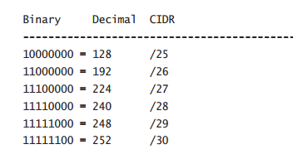
Subnetting Class C Addresses
In a Class C address, only 8 bits are available for defining the hosts
that subnet bits start at the left and go to the right without skipping
bits. This means that the only Class C subnet masks can be the
following:
The Fast Way Method: Subnetting a Class C Address
start by using the second subnet mask available with a Class C address, which borrows 2 bits for subnetting
192 = 11000000
The 1s represent the subnet bits, and the 0’s represent the host bits available in each subnet. 192 provides 2 bits for subnetting and 6 bits for defining the hosts in each subnet.

Slide 27
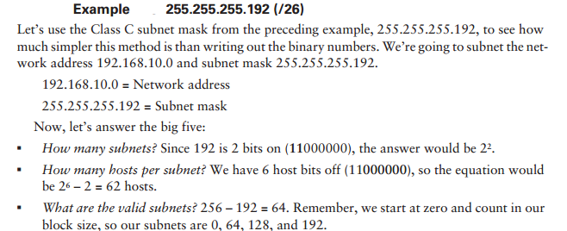
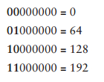

Slide 28
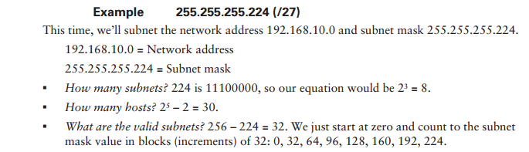

Slide 29
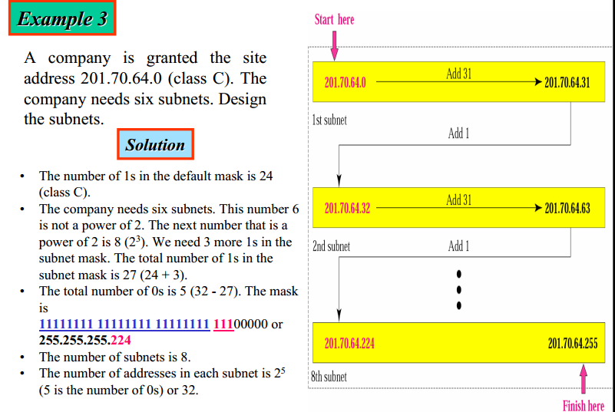

Slide 30
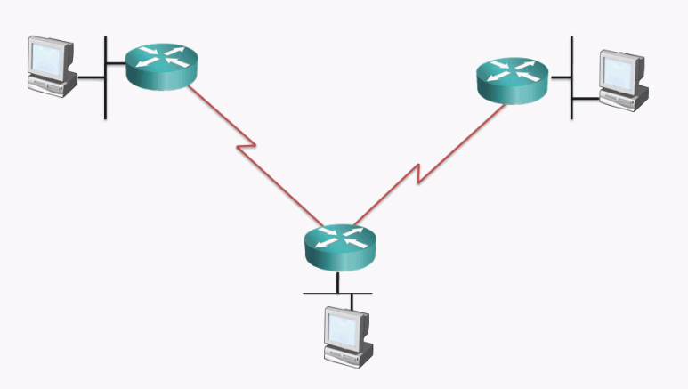
Example 4
An organization has purchased the Class C Address 216.21.5.0 and would like to use it to address the following 5 networks.

Slide 31
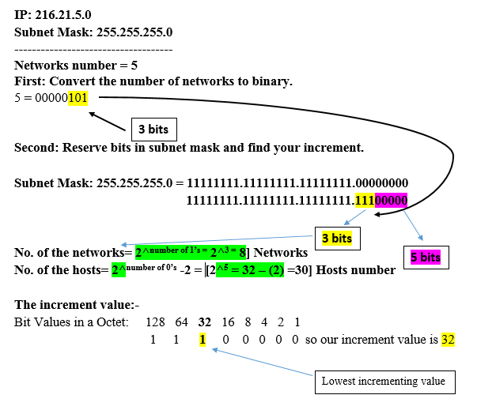
Cont…

Slide 32
Cont…
Third: Use increment to find the network ranges.
No. | Subnet address | First valid address | Last valid Address | Broadcast address
1 | 216.21.5.0 | 216.21.5.1 | 216.21.5.30 | 216.21.5.31
2 | 216.21.5.32 | 216.21.5.33 | 216.21.5.62 | 216.21.5.63
3 | 216.21.5.64 | 216.21.5.65 | 216.21.5.94 | 216.21.5.95
4 | 216.21.5.96 | 216.21.5.97 | 216.21.5.126 | 216.21.5.127
5 | 216.21.5.128 | 216.21.5.129 | 216.21.5.158 | 216.21.5.159
6 | 216.21.5.160 | 216.21.5.161 | 216.21.5.190 | 216.21.5.191
7 | 216.21.5.192 | 216.21.5.193 | 216.21.5.222 | 216.21.5.223
8 | 216.21.5.224 | 216.21.5.225 | 216.21.5.254 | 216.21.5.255

Slide 33
Cont…
216.21.5.33--62
216.21.5.1--30
216.21.5.129--158
216.21.5.97--126
216.21.5.65--94

Slide 34
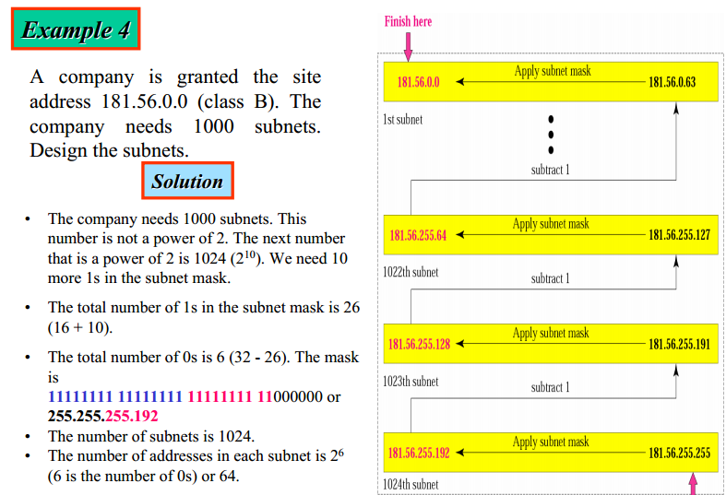
Example 5

Slide 35
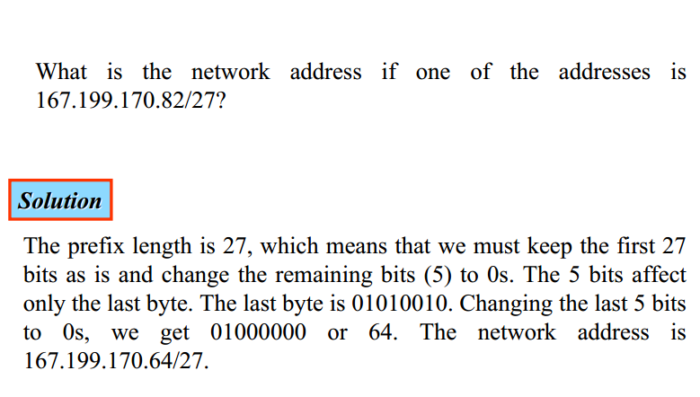
Example 6
Notes:
82 …. 01010010
………..11100000
64……01000000

Slide 36
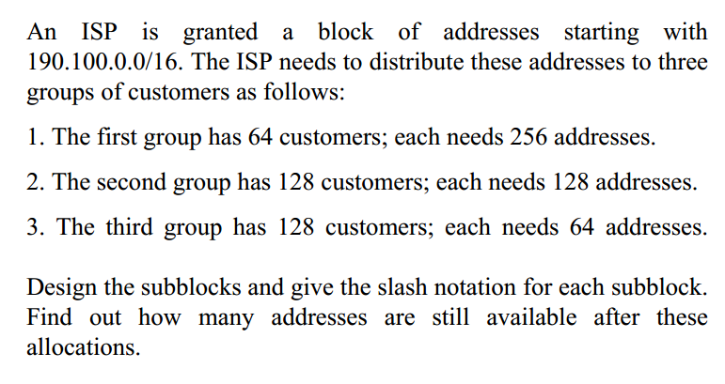
Example 7

Slide 37
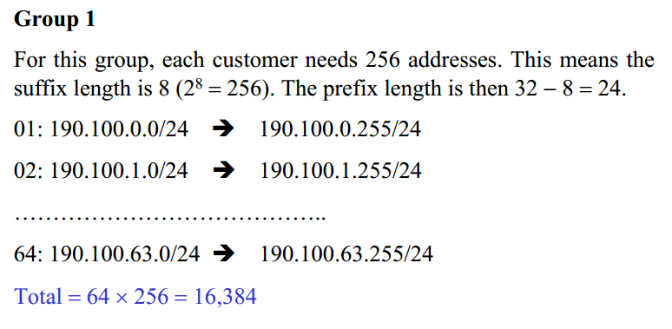

Slide 38
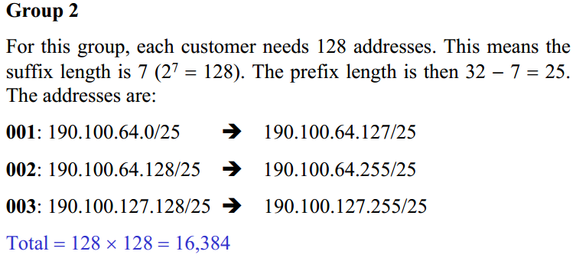
128:

Slide 39
Thank you

